Slide 1
Painless Public Relations for a Strong Future
What to advertise, who to reach, how to do it.

Slide 2
What to advertise, who to reach, how to do it.
Nancy Sheehan
Head of Youth Services
Lucius Beebe Memorial Library
Wakefield

Slide 3
It’s All About the Patron
Patron Values
  Reading
    Books
    Magazines
    Online
  Access
    “Third space”
    Wi-Fi
    Anonymity
    Ease of use

Slide 4
Patron Values
Information
  Print
  Online
  Current events, relevant topics
Technology
  Wi-Fi
  Computers and Laptops
  Printers: Color?
  Copiers: Color?
  eBook readers
  Downloadable audio and e-books

Slide 5
Patron Values
Service
  Readers’ Advisor
  Children’s Programs
  Museum Passes
What do YOU have to offer patrons that:
  Saves people time
  Saves people money
  Contributes to their quality of life
For every patron who asks, there is another dozen who doesn’t – and would like to know.

Slide 6
Publicize the Obvious and the Relevant
The Relevant
  Health Insurance
  Job Search
  Starting a Business
  Financial Aid
  College Information
  Test Prep
  Physician Search
  Any topic you have information on!
The Obvious: Library programs, hours, collections, story times, operational policies

Slide 7
Know Your Audience and Target Them
Borrowers
Computer Users
Story Time Moms
Seniors
Young Adults/Students
Men

Slide 8
Where Are Your Customers Now?
Borrowers: in the library, at home, at work
Computer Users: on the computer, online
Story Time Moms: in story time, at home, in car
Senior Readers: in the library, at home, social centers
Young Adults: school, with friends, socializing
Students: at school, social centers, online
Men: at work, on the field, at home, in car

Slide 9
How to Reach Them---CHEAP!
Borrowers: In-house publicity (fliers, bookmarks)
Computer Users: Facebook, Twitter, e-newsletters
Story Time Moms: Twitter, Facebook, cable access, newspapers, Patch
Seniors: in-house fliers, senior centers, Twitter, REI
Young Adults: Facebook, Tumblr, school announcements, parents
Students: Facebook, Tumblr, electronic newsletters to schools
Men: Wives, online, sports

Slide 10
The People You Don’t Know
Go where they go
  Soccer field
  Carnival
  Festivals and other social gatherings
  The dump
  School, preschool
  Any and all “social” networking sites –(NOT a virtual activity!)
Virality
  Start a “buzz”
  Get your patrons talking to your non-patrons

Slide 11
Time, Place, and Prime Real Estate
Programs and Events
  At least 1 circulation period
  The bigger the event, the more notice
  Give customers time to notice
Library Services and Products: “Key” moments
  National Library Week, library card drives,
  Teen Read Week, library “anniversaries”
  Local/Town Anniversaries
Prime Real Estate – Find it and use it

Slide 12
Conclusion
Include in the plan:
  Who do you want to target?
  Where are they, where will they be?
  What are their values, and how will you maximize that knowledge?
  How can you get on their radar?
Leverage your resources
  Patrons
  Space
  Staff
  Trustees

Slide 13
The Media Blitz in 4 easy steps
Olivia Melo
Director
Lakeville Free Public Library
Lakeville

Slide 14
Step 1
Have a blank press release saved in your documents with organization info.
Fill in the information as it applies to your program, remembering the 3 W’s
    WHEN
    WHO
    WHAT

Slide 15
Sample of Blank PR Form
Lakeville Public Library
4 Precinct St.
Lakeville, MA 02347
508-947-9028
DATE:
For Immediate Release:
This program is FREE and open to all ages.
If more information is needed regarding this program, please contact Library Director, Olivia Melo or email to omelo@sailsinc.org.
Library Hours: Sun. closed, Mon. 12-8, Tues. 10-8, Wed. 10-6, Thurs. 10-8, Fri. closed & Sat. 10-2

Slide 16
Completed PR Form
Lakeville Public Library
4 Precinct St.
Lakeville, MA 02347
508-947-9028
DATE: November 1, 2011
For Immediate Release:
“Herbs & their Legends”
Local herbalist Jim Norris will present a slide show at the Lakeville Library on Saturday, November 17th from 1-2 pm on
herbs and their legends.
Mr. Norris will discuss some of the stories and legends associated with certain herbs throughout his slide presentation.
Following the event, participants will tour the herb garden planted in the back of the library in memory of his late mother,
Evelyn D. Norris. The garden’s four themes include Literary, Cooking, Historical and Fragrance.
This presentation is FREE and open to all ages.
If more information is needed regarding this program, please contact Library Director, Olivia Melo or email
omelo@sailsinc.org.
Library Hours: Sun. & Mon. – Closed, Tues. 10-8, Wed. 10-6, Thurs. 10-8, Fri. 10-6 & Sat. 10-2

Slide 17
Step 2
Email your Press Release to your local contacts at least 2 weeks in advance.
    Most newspapers prefer electronic copy to simplify the process.
    Contact your local papers and get the email for the person or office responsible for community events.
    Keep a Media Contacts folder in your address book.
    Always start the email with a “if there is room in your publication, we would appreciate your help in getting the word out on this event” type of salutation.

Slide 18
Step 3
Add the program information to your online calendar, web page, newsletter, facebook.
    Create a Facebook event.
    Online calendars and Social Feeds.

Slide 19
Step 4
Create a flyer for bulletin boards, circulation desks, handout or bookmark to make available to the public.

Slide 20
Furthering the vision and brand with PR
Janet Stupak
Community Relations Coordinator
Springfield City Library
Springfield

Slide 21
Springfield City Library
Our Mission
Building Connections
Broadening Horizons
Strengthening Community

Slide 22
Vision
Working toward a brighter future for Springfield today-
Celebrating community, culture and history
Promoting success for Springfield residents in education, work and life

Slide 23
Values
A welcoming place for all
Responsive, quality customer service
A strong partner in the Springfield Community

Slide 24
Why do we use a style guide?
To build strong public awareness of the many products and services we offer
To present a consistent and recognizable style in our communications and publications
To enable easy design of correspondence and publications that are uniform with our brand
It makes my job easier!

Slide 25
Examples using our three color palettes
Primary – make up our library logos
Secondary – complement primary palette, for general usage
Youth color palette - for children’s and teens programs

Slide 26


Adult Programs…

Slide 27

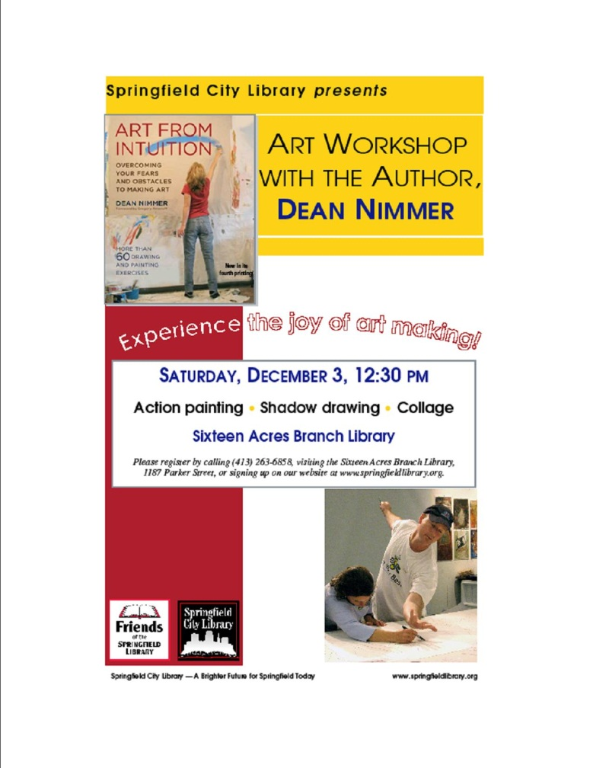
Additional Adult Programs

Slide 28
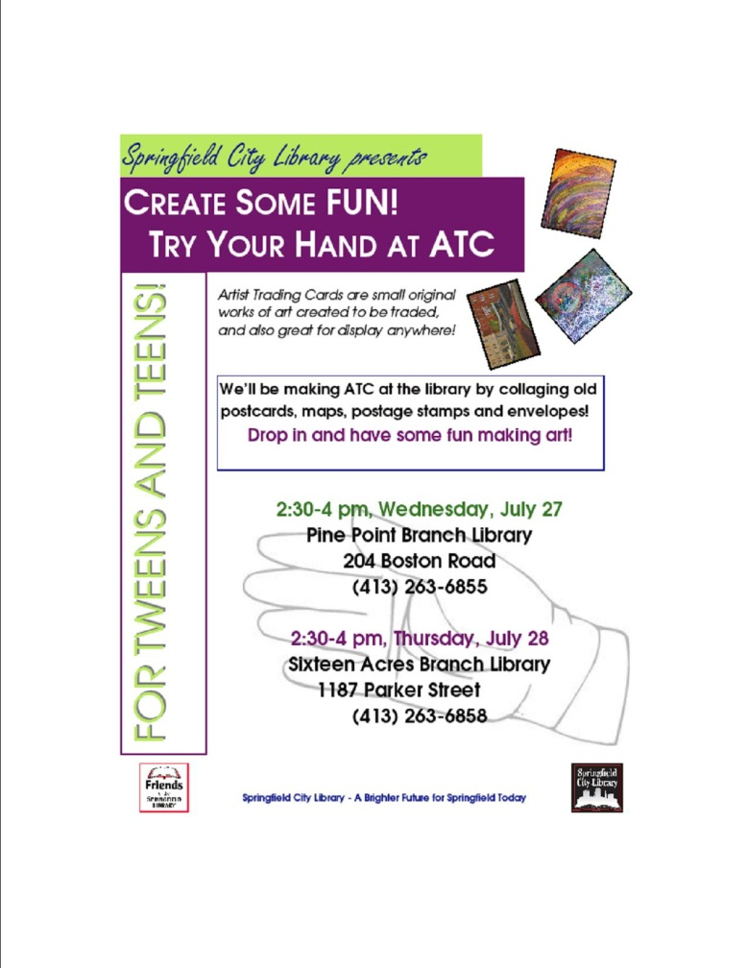
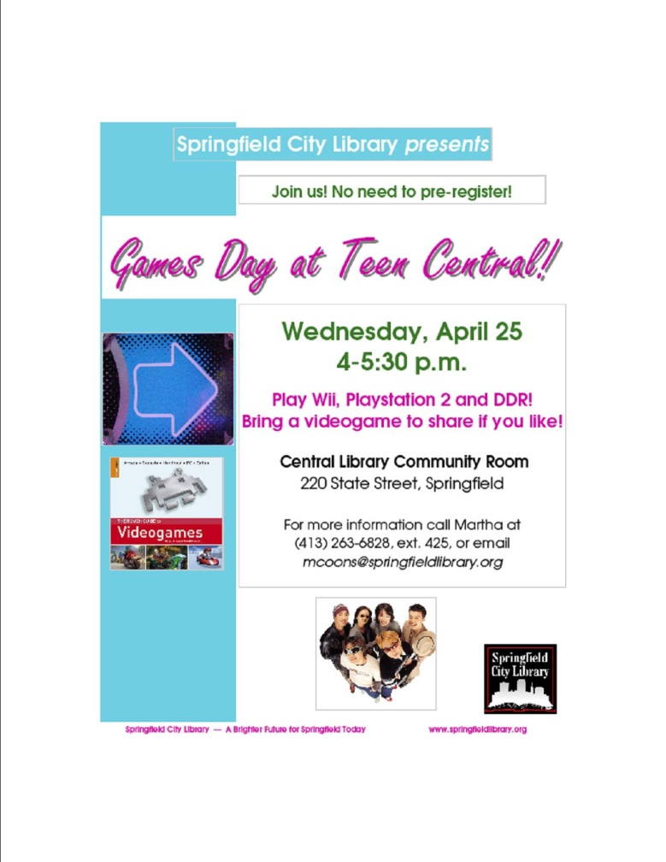
Teen Programs…

Slide 29

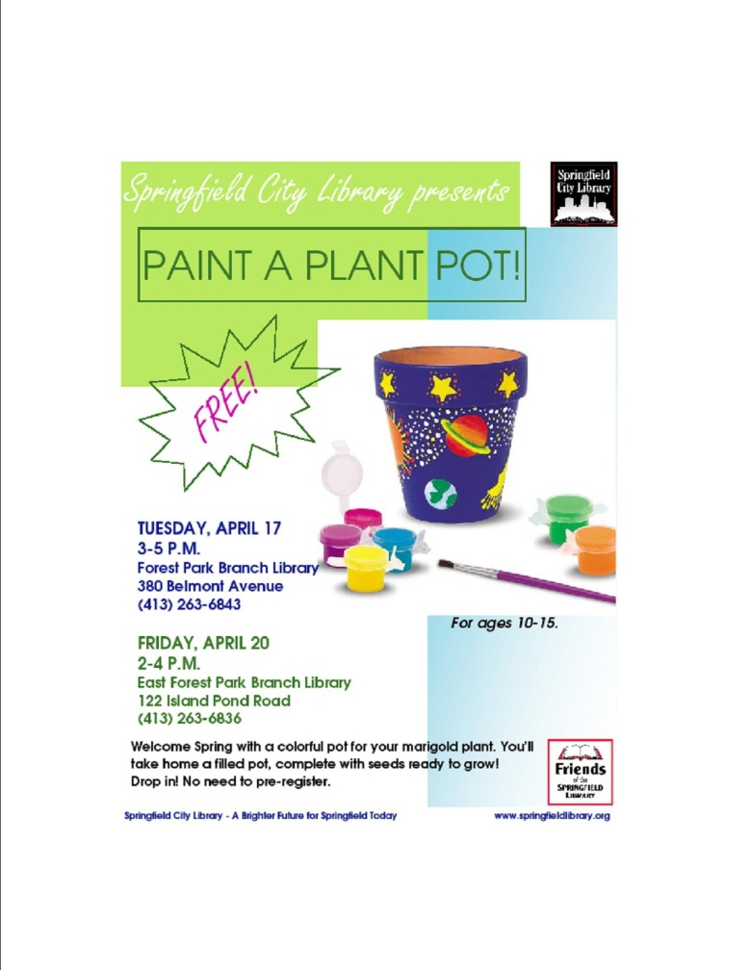
Two More for Teens!

Slide 30

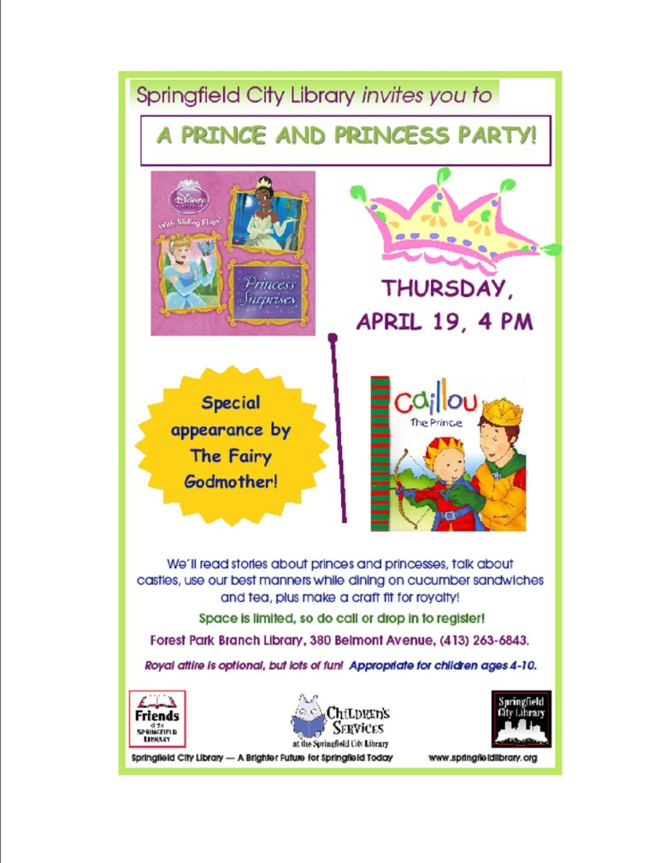
Attracting Children

Slide 31
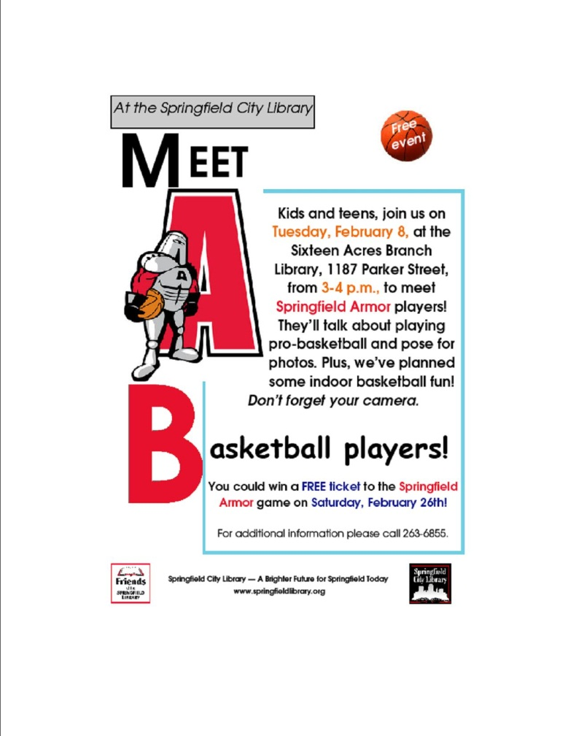

More for Children

Slide 32
Questions?
Thank you for joining us.

